Slide 1
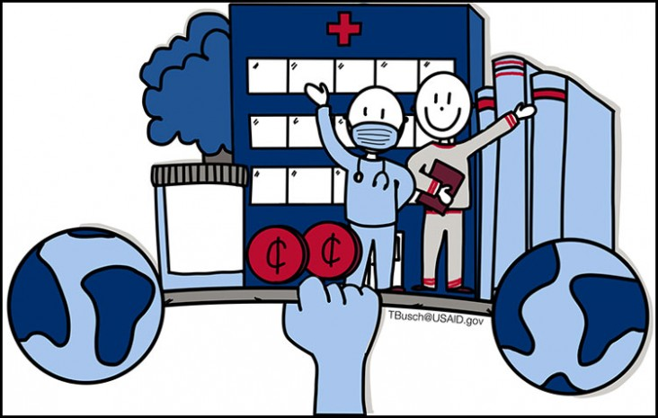
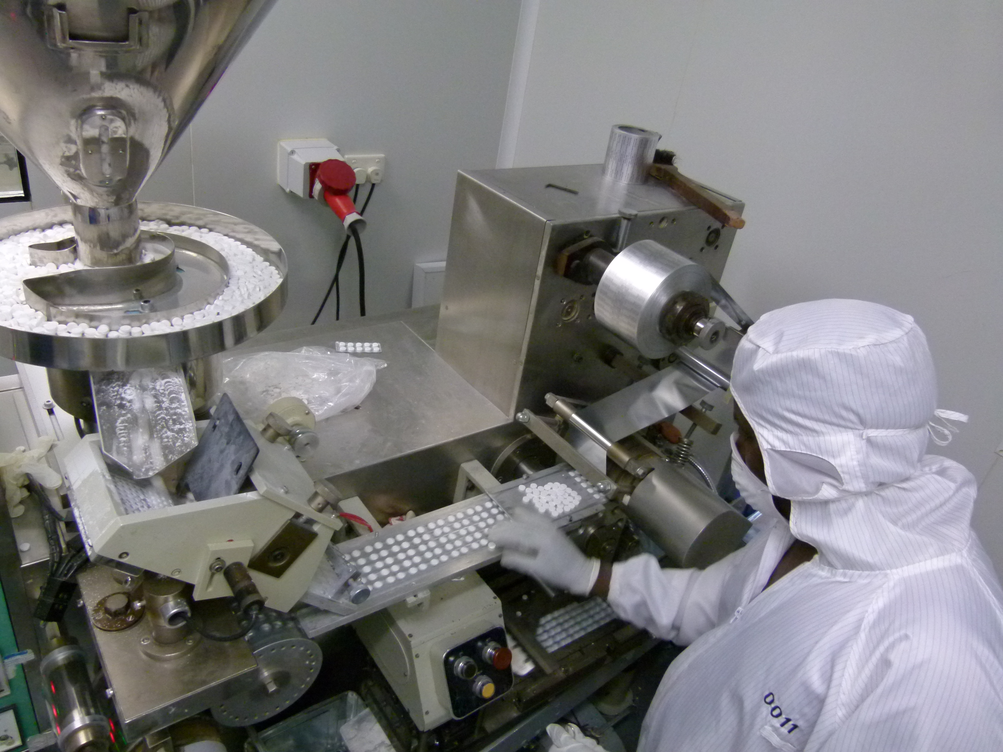
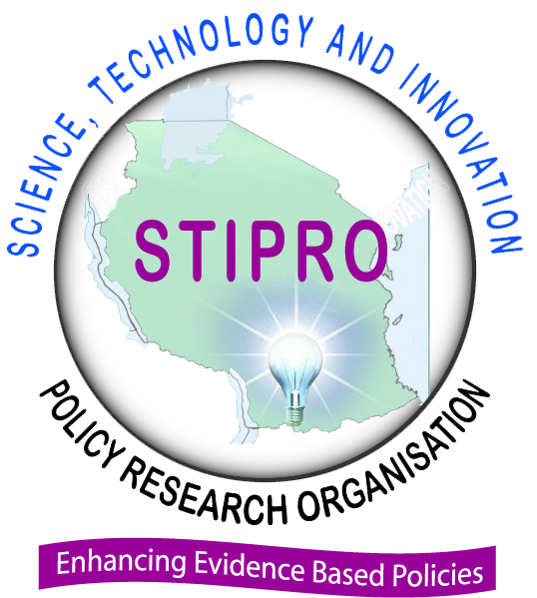
Public-Private Partnerships and Health System Strengthening in Southern Africa
Project Team: Dr Julius Mugwagwa - University College London and Dr Geoffrey Banda -University of Edinburgh
Project Goal & Key Objectives
The project’s goals were to provide new empirical data and evidence from Botswana, Namibia, South Africa, Zambia and Zimbabwe on how Public Private Partnerships (PPPs) can be an innovative mechanism of supporting local pharmaceutical production that:
supports local health
results in social inclusion
builds resilient, inclusive and sustainable responses to persistent and emerging health challenges to African countries
Research Approach & Methods
Using the conceptual framework of a health-industry complex [infrastructures, linkages, synergies and capabilities that link local pharmaceutical industry and healthcare delivery] we used a mixed methods approach [interviews, document reviews and site visits] to investigate the role of PPPs as an innovative mechanism provide finance, technological capabilities and new business models to resource limited African countries and improve social inclusion and local health security.
Findings and Implications
The policy environment is ready – study countries have PPP policies and most have used PPPs in health research and innovation, pharmaceutical manufacturing and health service delivery. However not all countries have specific departments that facilitate functioning of PPPs- except South Africa.
PPPs are a potential tool to deal with market deficiencies that hamper improved healthcare access and social inclusion. Government or the private sector working separately may not be able to cope with the risks and uncertainty associated with enterprise and providing a social good [healthcare].
PPPs aid economies of scale, particularly of procurement, service provision but also research and development and manufacturing.
PPPs can act as ‘system integrators’ leveraging knowledge and expertise across sectors public and private sectors to provide essential health technologies and healthcare services. For example PPPs in health financing, access to antiretroviral (ARV) drugs for HIV, and market access for diagnostics and treatments for care for HIV, TB and Malaria
Contribution to Capacity Strengthening
PPPs contribute to technological capability upgrading in the pharmaceutical sector
PPPs have contributed to better healthcare delivery in the Southern African countries studied
PPPs help consolidate and augment skills across the public and private sector divide
Sustainability and Next Steps
www.scinnovent.org
www.sgciafrica.org

