Slide 1
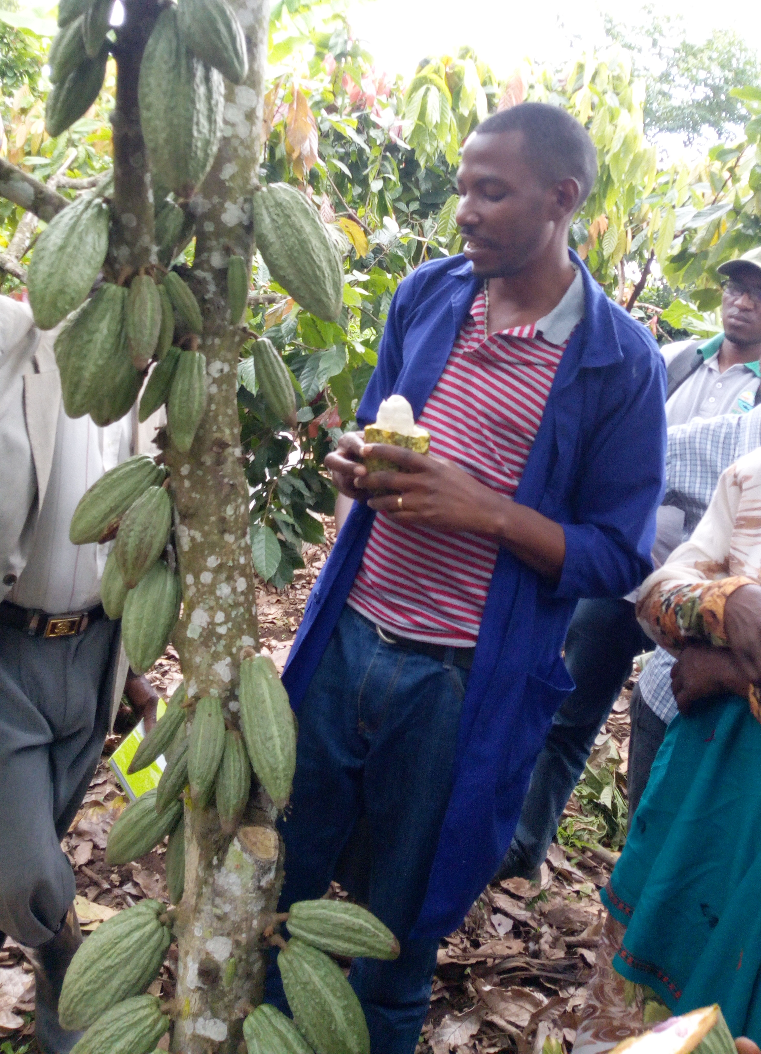
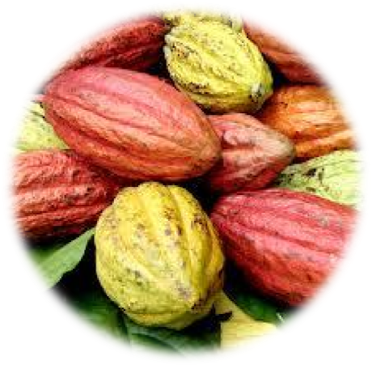
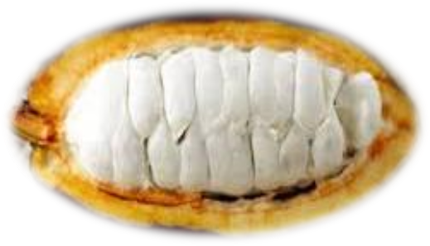
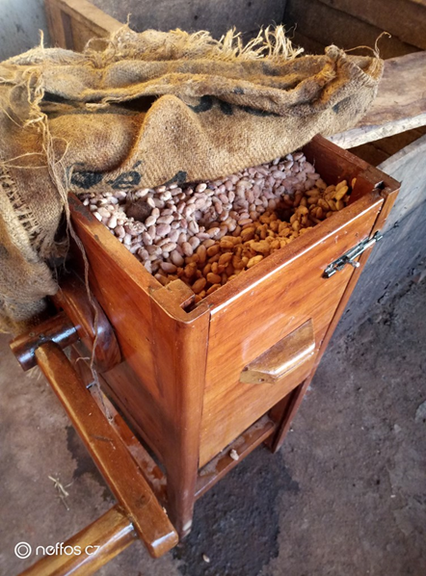
Cocoa waste to wealth using known yeast strains from Uganda fermentation box
Joseph Mulindwa, Kaaya, A.N., Daphne B. N., Muganga L. & Chemutai J.
National Coffee Research Organization (NaCORI); Makerere University, School of Food Technology, Nutrition & Bio-engineering
Project goal and objectives
Goal: Boost the income generating capacity of cocoa industry in the producing regions of Uganda;
Through:
Design of stainless steel tank for cocoa juice extraction and single box for cocoa fermentation
Development of value added products from cocoa juice
Promotion of farm level cocoa processing and local use of by-products
Research approach & methods
Findings and implication
Research, farmers
PROBLEM
Research
PROCESS INNOVATION
Research and processors
OUTPUTS
Farmers, extension workers, society, government and policy
IMPACT
Underutilized cocoa waste;
Poorly fermented cocoa beans with variable quality
Using known yeast starter culture to ferment cocoa;
Modified fermentation process
Well fermented cocoa beans
New products (brandy and wine)
Publications
Better prices
Extra income to farmers
Consistent quality and assured safety)
Environmentally friendly processes
Better governance of the cocoa value chain
Laborious fermentation method
Value addition to wastes
Single box reduces fermentation time by 2 days and achieves 95% full fermented beans
Extraction of excess juice improves the quality of fermented beans (80%) compared to non extracted pulp (53%); and reduces fermentation time by 1 day
Juice from cocoa has high brix (17.7%) suitable for production of ethanol and wines
Capacity strengthening
Through the project, National Coffee Research Institute has;
Functional collaborations with farmers and exporters
Attracted more funding on cocoa (CGS)
Trained one bachelor degree student
Over 140 extension cocoa workers have been trained
Sustainability and next steps
Over 15,000 households are small scale cocoa farmers harvesting between 100-200kg bi-weekly. Single box can handle small quantities, cheap to construct and gender inclusive.
Value addition to juice can be done on-farm and requires less complicated machinery.
Working with private sector, continuous training on applicability of innovation will be prioritized for increased adoption
Single box operates on principle of engine crank
Ph_Temp profile were recorded at 24 h interval
Sensory for wine focused on bitterness, smell, and acidity
Extraction of cocoa juice using SST (20%,17%, 15%)
Production of dry wine and brandy from the cocoa juice
Fermentation of cocoa beans using single box along side stacked boxes as control
www.scinnovent.org
www.sgciafrica.org

